Slide 1
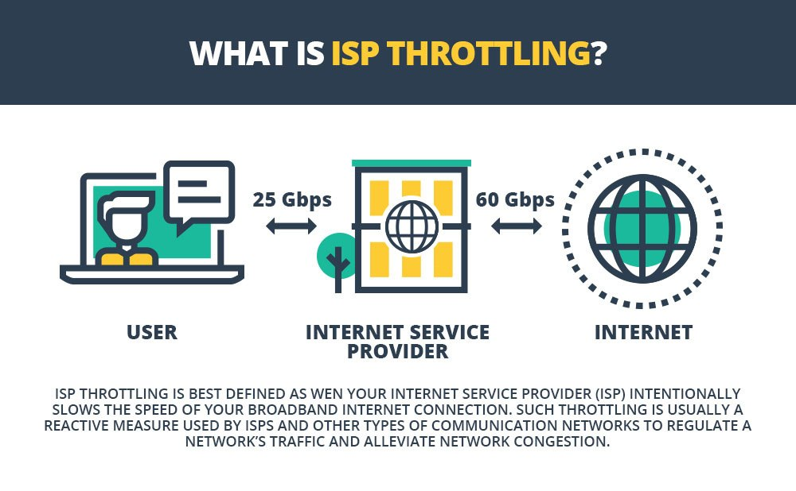
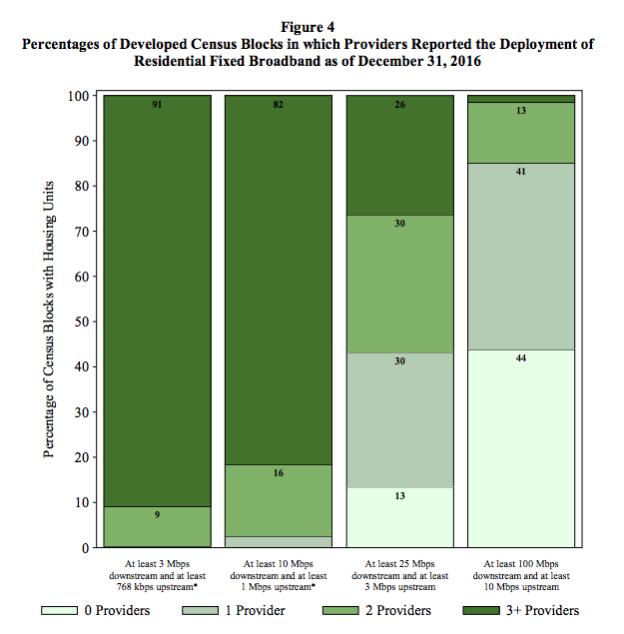
The necessity of network neutrality
Mohamed Bakkar <mbakkar@andrew.cmu.edu>
Introduction
Net neutrality is the idea that Internet Service Providers should be required to treat all internet traffic equally, without halting, slowing, or blocking, except for legitimate purposes.
ISPs have been shown to repeatedly discriminate against certain traffic, necessitating such regulation.
Net Neutrality protects ideals such as freedom of speech, freedom of expression, and healthy competition.
Examples of non-neutrality
Protecting speech & competition
Although net neutrality has come to the forefront of public consciousness recently, it has always been an issue.
Cox and Comcast ban users from using virtual private networks (2003).
Madison Rivers Communications blocks VoIP (2005).
AT&T censored two lines from a Pearl Jam song seen as anti-Bush (2007).
Comcast begins to throttle P2P traffic (2007).
Time Warner Cable throttles online game League of Legends (2013).
Comcast grants Netflix a ”fast lane” for a fee (2014).
AT&T, Verizon, T-Mobile, and Sprint throttle popular video apps such as Netflix, Amazon Prime, and YouTube (2018).
The same infrastructure that ISPs use to throttle and block content can be used to block speech. We saw at least one such example with the Pearl Jam lyrics censorship.
Numerous countries have differing levels of internet censorship, possible because of the aforementioned infrastructure. In the UK, pornography websites will be censored in July 2019, requiring age verification for access. In China, political speech critical of the ruling party is banned, among many other things.
Free competition is also threatened. Network neutrality provides a level playing field for new companies that can’t afford to pay for a “fast lane.”
Net neutrality prevents ISPs from charging extra for consumers to access certain services (e.g. an extra fee for accessing video streaming websites). This also prevents ISPs from choosing “winners” by favoring certain companies.
In some developing countries free basic internet is provided with limited services, favoring big players (such as Facebook’s “Free Basics”). While this may have positive outcomes, the motivations may not be wholly ethical.
Comparing ISPs and public utilities
Like telecommunications, energy, and water utilities, ISPs simply transfer something (internet traffic) from Point A to Point B. The former are heavily regulated.
It could be argued that ISPs are a natural monopoly because of the large barrier to entry.
The state of competition for fast broadband (25mbps and above) is woeful, see below. For reference, the minimum recommended speed for streaming HD video is 5mbps.
Conclusion
There are many examples of internet non-neutrality having concretely negative effects.
Non-neutrality opens the door for the erosion of free speech and competition.
Many parts of the US lack competition between ISPs (for fast broadband), and this problem is further exacerbated by municipalities purposefully favoring a specific ISP through legislation.
Because of these concerns, ISPs should be regulated just as public utilities are.

